Slide 1

Data Structures and Algorithms: Dynamic Programming
ICS 340
(Cormen, Chapter 15)

Slide 2
Overview
Dynamic Programming Examples
Rod cutting (text)
Fibonacci number calculation
Coin changing
Dynamic Programming Properties
Optimal Substructure
Overlapping Subproblems
More Dynamic Programming Examples
Edit Distance
Box stacking
Optimal BSTs
Bitonic Tour for TSP

Slide 3
Design Strategies We Cover
1. Divide & Conquer (previous)
2 . Dynamic Programming (now)
3. Greedy Algorithms (next)

Slide 4
Remember: Divide-and-Conquer
Divide and conquer was useful when we had a problem that could be divided up into subproblems such that
The subproblems were disjoint
The solution to the problem was the solution to one of the subproblems, or a step-by-step buildup of solutions to the subproblems, starting with the smallest ones.
Normally, divide-and-conquer works when there is one solution to a problem.
If you’re doing recursion, you never make the same recursive call twice.

Slide 5
Disjointness
Subproblems are not always disjoint.
Dynamic Programming is one powerful technique for dealing with some such problems.
Especially when there are many solutions but the goal is to find the optimal solution.
It yields polynomial time algorithms (often)
Often these are just “brute force” algorithms in which you can cleverly prune unused portions.
Dynamic Programming works when problems have:
Overlapping subproblems, and
Optimal substructure

Slide 6
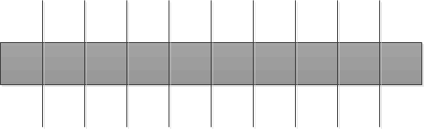
Problem intro: Rod Cutting
We manufacture long rods that can be cut into different shapes by 10ths. The selling price of each length of rod is given in the following table:
Slightly different from textbook
length | 1 | 2 | 3 | 4 | 5 | 6 | 7 | 8 | 9 | 10
price | 1 | 5 | 8 | 9 | 14 | 17 | 17 | 20 | 24 | 25
unit price | 1 | 2.5 | 2.67 | 2.25 | 2.7 | 2.83 | 2.43 | 2.5 | 2.67 | 2.5

Slide 7
Problem intro: Fibonacci Number Calculation
Fib(0) = 1
Fib(1) = 1
Fib(n) = Fib(n-1) + Fib(n-2), n > 1
Note that the obvious algorithm here is recursive.
But we can speed it up by using Dynamic Programming

Slide 8
Problem intro: Coin Changing
Suppose you want to figure out the smallest number of coins that are necessary to make exact change.
To make it simpler, let’s assume that we only want to make change up to one dollar (or British pound or Euro or whatever).
Yes, this means that the maximum problem size is so small that a brute force algorithm would be fine, but it illustrates our point well.

Slide 9
Contrast: Greedy Algorithms
There are “quick and dirty” algorithms for rod cutting and coin changing called “greedy” algorithms.
Greedy algorithms solve a problem by
Taking the “obvious” first step,
Considering the problem remaining after that first step
Taking the “obvious” first step of the smaller problem
Etc.
It can work well, it’s fast, but it’s not always optimal.
We will discuss Greedy Algorithms after discussing Dynamic Programming.

Slide 10

Greedy Rod Cutting
One greedy algorithm tells us to cut the rod into the piece with the highest unit price, and the remainder.
A piece of length 6 and one of length 4.
Highest unit price is for a rod of length 6.
Might further cut the length 4 piece into a 3 and a 1.
Highest unit price is with 3.
Although 2 & 2 looks better after even a cursory glance.
Clearly, this won’t be an optimal solution.
length | 1 | 2 | 3 | 4 | 5 | 6 | 7 | 8 | 9 | 10
Price p(n) | 1 | 5 | 8 | 9 | 14 | 17 | 17 | 20 | 24 | 25
unit price | 1 | 2.5 | 2.67 | 2.25 | 2.7 | 2.83 | 2.43 | 2.5 | 2.67 | 2.5

Slide 11

Optimal Rod Cutting
You can find the maximum revenue by trying every possible set of rod lengths that add up to 10.
The maximum revenue is found by cutting the rod into two pieces of length 5, as shown next.
A recursive brute force approach such as this will always give the optimal answer.
And it can be sped up by dynamic programming.
length | 1 | 2 | 3 | 4 | 5 | 6 | 7 | 8 | 9 | 10
price | 1 | 5 | 8 | 9 | 14 | 17 | 17 | 20 | 24 | 25
unit price | 1 | 2.5 | 2.67 | 2.25 | 2.7 | 2.83 | 2.43 | 2.5 | 2.67 | 2.5

Slide 12
Brute Force Rod Cutting
10 |  |  |  |  |  |  | 25
9 | 1 |  |  |  |  |  | 25
8 | 2 |  |  |  |  |  | 25
8 | 1 | 1 |  |  |  |  | 22
7 | 3 |  |  |  |  |  | 25
7 | 2 | 1 |  |  |  |  | 23
7 | 1 | 1 | 1 |  |  |  | 20
6 | 4 |  |  |  |  |  | 26
6 | 3 | 1 |  |  |  |  | 26
6 | 2 | 2 |  |  |  |  | 27
6 | 2 | 1 | 1 |  |  |  | 24
6 | 1 | 1 | 1 | 1 |  |  | 21
5 | 5 |  |  |  |  |  | 28
5 | 4 | 1 |  |  |  |  | 24
5 | 3 | 2 |  |  |  |  | 27
5 | 3 | 1 | 1 |  |  |  | 24
5 | 2 | 2 | 1 |  |  |  | 25
5 | 2 | 1 | 1 | 1 |  |  | 22
5 | 1 | 1 | 1 | 1 | 1 |  | 19
4 | 4 | 2 |  |  |  |  | 23
4 | 4 | 1 | 1 |  |  |  |  |  |  | 20
4 | 3 | 2 | 1 |  |  |  |  |  |  | 23
4 | 3 | 1 | 1 | 1 |  |  |  |  |  | 20
4 | 2 | 1 | 1 | 1 | 1 |  |  |  |  | 18
4 | 1 | 1 | 1 | 1 | 1 | 1 |  |  |  | 15
3 | 3 | 3 | 1 |  |  |  |  |  |  | 25
3 | 3 | 2 | 2 |  |  |  |  |  |  | 26
3 | 3 | 2 | 1 | 1 |  |  |  |  |  | 23
3 | 3 | 1 | 1 | 1 | 1 |  |  |  |  | 20
3 | 2 | 2 | 2 | 1 |  |  |  |  |  | 24
3 | 2 | 2 | 1 | 1 | 1 |  |  |  |  | 21
3 | 2 | 1 | 1 | 1 | 1 | 1 |  |  |  | 18
3 | 1 | 1 | 1 | 1 | 1 | 1 | 1 |  |  | 15
2 | 2 | 2 | 2 | 2 |  |  |  |  |  | 25
2 | 2 | 2 | 2 | 1 | 1 |  |  |  |  | 22
2 | 2 | 2 | 1 | 1 | 1 | 1 |  |  |  | 19
2 | 2 | 1 | 1 | 1 | 1 | 1 | 1 |  |  | 16
2 | 1 | 1 | 1 | 1 | 1 | 1 | 1 | 1 |  | 13
1 | 1 | 1 | 1 | 1 | 1 | 1 | 1 | 1 | 1 | 10

Slide 13
Rod Cutting - Approach
You have to pick the correct recursive formulation of the problem.
You have to pick the correct dynamic programming approach to speed it up.
In general, dynamic programming algorithms are tricky to design but make for short programs.
length | 1 | 2 | 3 | 4 | 5 | 6 | 7 | 8 | 9 | 10
price | 1 | 5 | 8 | 9 | 14 | 17 | 17 | 20 | 24 | 25
unit price | 1 | 2.5 | 2.67 | 2.25 | 2.7 | 2.83 | 2.43 | 2.5 | 2.67 | 2.5

Slide 14
Recursive Formulation - Fibonacci Numbers
The formulation of the recursive Fibonacci Number calculation problem is obviously the definition itself:
Fib(0) = 1
Fib(1) = 1
Fib(n) = Fib(n-1) + Fib(n-2), n > 1

Slide 15
Dynamic Solution
A dynamic programming solution is usually a brute force recursive solution modified to make it faster.
Normally this is done by saving intermediate results of calculations so that they can be reused.
Make $0.75 change
Quarter + $0.50, OR Dime + $0.65, OR Nickel + $0.70.
2 Nickels + $0.65
Basically, in some recursive algorithms you may end up making the same recursive call more than once.
If you can replace the recursive calls after the first one with table lookups, you have sped up the algorithm.
That’s dynamic programming in a nutshell.

Slide 16
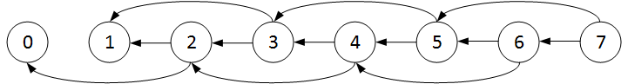
Subproblem Graphs
To see the recursion, some people like to draw a “subproblem graph”.
This is a subproblem graph for calculating the Fibonacci numbers

Slide 17

Brute Force Fibonacci Number Program
Fib( n ) {
if ( ( n == 0 ) || ( n == 1 ) )
return 1;
else
return Fib(n-1) + Fib(n-2);
}
T(n) = T(n-1) + T(n-2) + Θ(1).
Lots of recursive calls.
This takes exponential time.

Slide 18
Speeding Up The Recursion
So we have a way to find the optimal solution in exponential time.
This isn’t really helpful.
But there are two ways to make these polynomial:
Top down memoization
Bottom up tabulation

Slide 19
Bottom up – Fibonacci numbers
Make a table and work upwards. Calculating each additional Fibonacci number takes constant time (one addition).
N | 0 | 1 | 2 | 3 | 4 | 5 | 6 | 7
Fib(n) | 1 | 1
N | 0 | 1 | 2 | 3 | 4 | 5 | 6 | 7
Fib(n) | 1 | 1 | 2
N | 0 | 1 | 2 | 3 | 4 | 5 | 6 | 7
Fib(n) | 1 | 1 | 2 | 3
N | 0 | 1 | 2 | 3 | 4 | 5 | 6 | 7
Fib(n) | 1 | 1 | 2 | 3 | 5
N | 0 | 1 | 2 | 3 | 4 | 5 | 6 | 7
Fib(n) | 1 | 1 | 2 | 3 | 5 | 8

Slide 20

Fibonacci Number Top-Down Dynamic Program
// Initialize fibAry[] to {0,0,…,0} in main program
// At the end of the method, fibAry will contain the Fibonacci numbers 0-n.
int Fib( int n, int[] fibAry ) {
if ( ( n == 0 ) || ( n == 1 ) )
fibAry[n] = 1;
else if { fibAry[n] != 0 )
return fibAry[n];
else {
int f = Fib(n-1,fibAry) + Fib(n-2,fibAry);
fibAry[n] = f;
return f;
}
}

Slide 21

Fibonacci Number Bottom-Up Dynamic Program
int Fib( int n ) {
// Initialize int fibAry[] to {0,0,….,0}
for ( int j = 0; j <= n; j++ ) {
if ( ( j == 0 ) || ( j == 1 ) )
fibAry[j] = 1;
else
fibAry[j] = fibAry[j-1] + fibAry[j-2];
}
return fibAry[n];
}

Slide 22
Fibonacci Numbers: Best Dynamic Program
For Fibonacci numbers, the best dynamic program is bottom up.
Top-down DPs work best if you will need to calculate some, but not nearly all, of the smaller subproblems.
Coin changing is a good example of this.
The number of coins is much less than the number of possible amounts of change.

Slide 23

Recursive Formulations
In general, the hard part of dynamic programming is the recursive formulation.
Much of the non-programming work in the class will revolve around getting the correct recursive formulations.
That does not mean that converting the recursion into code is easy!

Slide 24

Recursive Formulation - Rod Cutting
Assume the price of an uncut rod of length n is p_{n}.
Then the optimal revenue r_{n} from cutting up a rod of length n is:
r_{n} = max( p_{n}, p₁+r_{n-1}, r₂+r_{n-2}, …, r_{n-1}+p₁) , 1 ≤ i ≤ n

Slide 25

Cleaner Formulation
r_{n} = max( p_{n}, r₁+r_{n-1}, r₂+r_{n-2}, …, r_{n-1}+r₁) , 1 ≤ i ≤ n
It doesn’t matter whether you cut from the left or right end.
So cut off a piece of length i at the left, then
r_{n} = max(p_{i} + r_{n-i}), 1 ≤ i ≤ n

Slide 26

Brute Force Rod Cutting Algorithm
cutRod(p[],n) {
if ( n == 0 )
return 0;
q = 0;
for (i = 1 to n)
q = max(q, p[i] + cutRod(p[],n-i));
return q;
}
Lots of recursive calls
T(n) = Θ(1) + Σ₀^{n-1} T(j)
This takes exponential time.

Slide 27
Bottom up – Rod Cutting
Start with the maximum revenue generated by a rod of length 1. (Just p₁)
Then calculate the maximum revenue for a rod of length 2 (1 & 1 or an uncut rod)
Work your way up to full length.
Note that one issue we haven’t discussed yet is keeping track of what cuts give you the optimal result.

Slide 28
Top Down
Same as bottom up, except you start with the original problem.
When the recursion bottoms out, you fill in the bottomed-out table value.
When you work your way back up the recursion tree, you fill in the intermediate results as you go.
Sometimes called “memoization”.
Often better than bottom up when you don’t expect to have to calculate most of the smaller subproblems.

Slide 29
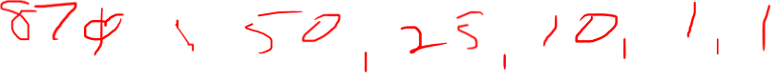
Coin changing
There are many different systems of denominations for coins/bills. Here are three:
Old (pre-1971) British system:
0.5p, 1p, 3p, 6p, 12p, 24p, 36p, 60p, 1₤, 2 ₤, 5 ₤, 10 ₤
Modern British system:
1p, 5p, 10p, 20p, 50p, 1₤, 2 ₤, 5 ₤, 10 ₤
American system:
1₵, 5 ₵, 10 ₵, 25 ₵, 50 ₵, $1, $2, $5, $10, $20, $100

Slide 30
Coin changing
In some systems it’s always optimal to give back change by starting with the largest denomination; in others it’s not.
In fact, it’s related to “Matroid Theory” which is a graduate level topic (read the end of CLRS Chapter 16 if you’re interested).
But a recursive brute force approach will always work give the optimal solution.
And it can be sped up by dynamic programming.

Slide 31

Formulation of Coin Changing Program I
Suppose I want to make change for amount m of money. I have c different coins, each of value v_{i}, i=1,…,c. Assume there are plenty of coins of each denomination.
Assume that if j < k, v_{j} > v_{k}
In other words, coins ordered from greatest to least value (doesn’t really matter but quicker)
I want to minimize the number of coins N(m) that I use.

Slide 32

Formulation of Coin Changing Program II
Then to minimize the number of coins to make change of amount m:
I determine the minimum number of coins to make change amount m-v_{j} for each j
I find the minimum of all the above, and add one coin.
So if N(m) is the minimum number of coins to make change of amount m, then I can write the following equation:

Slide 33
Brute Force Coin Changing Algorithm
// m and v meanings on previous slide
int minChg( int m, int[] v ) {
if ( m == 0 ) {
return 0;
}
nrCoins = 0;
for (k=0; k<v.length, v[k]<=m; k++) {
nrCoins = 1+min(minChg(m-v[k], int[] v) );
}
return nrCoins;
}

Slide 34
Comment
The above equations tell us the minimum number of coins we need.
A practical solution would also have to tell us which coins were used.

Slide 35
Optimal Substructure
Problems which yield to dynamic programming have subproblems which are subsets/extensions of the original problem
The optimal solution to each problem contains within it the optimal solution to its subproblems.
http://www.geeksforgeeks.org/dynamic-programming-set-2-optimal-substructure-property/

Slide 36
Overlapping Subproblems
Problems that yield to dynamic programming have the property of overlapping subproblems.
To solve the larger problem, you can create the solution to the larger problem from the solution to the subproblems.
http://www.geeksforgeeks.org/dynamic-programming-set-1/

Slide 37
Longest Common Subsequence
The longest common subsequence (LCS) of two strings is the longest set of characters that appear in the same relative order in both strings
regardless of the number of characters between characters of s in one string or the other
Example:
s1 = abcfgjklnopr
s2 = acdefhijkmnop
LCS = acfjknop

Slide 38
Longest Common Subsequence II
The brute force way to solve this problem is to generate every subsequence of each sequence, and find matching subsequences and output the longest one.
How many such subsequences are there?
Let C^{n}_{k} denote the number of subsequences of length k in a string of length n. Then the number of subsequences is:
C^{n}₀ + C^{n}₁ + … + C^{n}_{n-1} + C^{n}_{n} = 2^{n}

Slide 39
Longest Common Subsequence III
So you need to generate 2^{n} subsequences, and each of them takes time O(n) to compare against all the subsequences in the other string. So the brute force algorithm is O(n2^{n}). Worse than exponential.
But this can be done with Dynamic Programming in a much quicker time.

Slide 40
Longest Common Subsequence IV
We can show that LCS problem has optimal substructure and overlapping subproblems by writing the recursion equation for it and examining that equation.
So suppose that we are looking for the LCS of two subsequences of lengths m and n respectively. Call them
X[0..m-1]
Y[0..n-1]
Denote the LCS of these two sequences by
L(X[0..m-1],Y[0..n-1])

Slide 41
Longest Common Subsequence V
Then there are two possibilities, working backwards.
The last characters of the sequences match
X[m-1] = Y[n-1]. In this case,
L(X[0..m-1],Y[0..n-1]) = 1 + L(X[0..m-2],Y[0..n-2])
The last characters of the sequences do not match
X[m-1] != Y[n-1]. In this case,
L(X[0..m-1],Y[0..n-1]) =
Max ( L(X[0..m-2],Y[0..n-1]) , L(X[0..m-1],Y[0..n-2])

Slide 42
Longest Common Subsequence VI
This has optimal substructure because the optimal solution to the entire problem contains the optimal solution to subproblem(s).
And it has overlapping subproblems in the case where X[m-1] != Y[n-1].

Slide 43
Edit Distance I
Similar to the LCS problem from the textbook, but slightly different.
Suppose that you are making a spell checker with suggestions for misspelled words. You would like to be able to find the words that are “closest” to the string of non-word letters somebody typed.
Those words can differ from the typed string by
Missing a letter
Having an extra letter
Having a letter replaced with another letter

Slide 44
Edit Distance II
Suppose you have two strings, A and B.
A has length n, call it A[1..n],
B has length m, call it B[1..m]
What is the minimum number of errors (deletions, insertions, or replacements) needed to convert A to B?
Suppose the costs are:
C_{i} is the cost of an insert
C_{d} is the cost of a delete
C_{r} is the cost of a replacement

Slide 45
Edit Distance III - Aside
“Cost” here is a funny term. What could the “cost” mean? (for discussion)
Could mean relative probabilities of making the given types of error
Missing a character (thus requiring an insert)
Typing an extra character (thus requiring a delete)
Typing the wrong character (thus requiring a replacement)

Slide 46
Edit Distance IV
We want to do this as a recursive program that can be converted into a dynamic program, so we will build this up from substrings, starting at the beginning.
Let T(j,k) denote the minimum cost to transform substring A[1..j] to substring B[1..k].
Then there are four ways to convert A[1..j] into B[1..k].

Slide 47
Edit Distance V
Delete the j-th character of A[1..j], and convert the first j-1 characters of A into the first k characters of B
This has cost C_{d} + T(j-1,k)
Convert the first j characters of A into the first k-1 characters of B, and insert a k-th character into B[1..k-1].
This has cost C_{i} + T(j,k-1)
Replace the j-th character of A with the k-th character of B and convert the first j-1 characters of A into the first k-1 characters of B
This has cost C_{r} + T(j-1,k-1)

Slide 48
Edit Distance VI
If characters A[j] = B[k], just convert A[1..(j-1)] into B[1..(k-1)]
This has cost T(j-1,k-1)
This can be written as a recurrence, taking the minimum over all four alternatives at each step:

Slide 49
Edit Distance VII
This takes a total O(mn) time to run, because it solves mn subproblems, each of which takes constant (or zero) time.

Slide 50
Box Stacking I
Suppose that I have n boxes, each of which must be in a certain orientation (i.e., “this side up”).
The i-th box has a height h_{i}, and base w_{i} x d_{i} (where the width and the depth are interchangeable).
Your goal is to make the highest possible stack of boxes, holding to the following constraint:
A box k can only be stacked on top of a box m if the w_{k} ≤ w_{m} and d_{k} ≤ d_{m}.
Note that it’s possible that for any given two boxes, neither may be stacked on the other.

Slide 51
Box stacking II
Create a partial ordering of the boxes box₁, box₂, …, box_{n} such that for all i,j with i<j, box j cannot be stacked on top of box i.
Sort by base area.
Denote the height of the tallest stack of boxes with box j on the top as H(j).

Slide 52
Box stacking III
Then the height of the tallest such stack of boxes with box j on the top is given by
So the height of the tallest stack of boxes overall is given by

Slide 53
Box Stacking IV: Running Time Analysis
You can have one of n boxes on top, for each of those boxes, building up the solution, you can have O(n) boxes adjacent to it.
Another way to say this is that you start with the box you can’t stack on anything (leftmost box in array).
Then as you go up the array, the highest stack is the highest stack before that element, or the highest stack before that element plus its height.
You look at up to n boxes, up to n times, so it’s an O(n²) algorithm.
A really good set of mini-lectures on solving various dynamic programming problems is found here.
You need a 3rd-party flash-playing app to play it.

Slide 54
Optimal BST
Suppose that the cost of searching a binary search tree for an item is the number of nodes visited (the number of items looked at).
If the item isn’t in the tree, you look at items until you get to a leaf and then return failure.
Suppose we want to set up a binary search tree to minimize the total cost of searching.
We need to know the probability of searching for any given item, and the probabilities of searching for each item not in the tree.

Slide 55
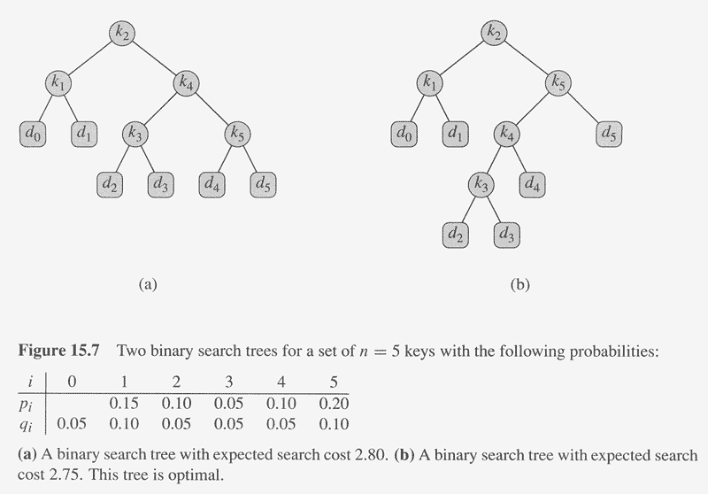
Copyright © The McGraw-Hill Companies, Inc. Permission required for reproduction or display.

Slide 56
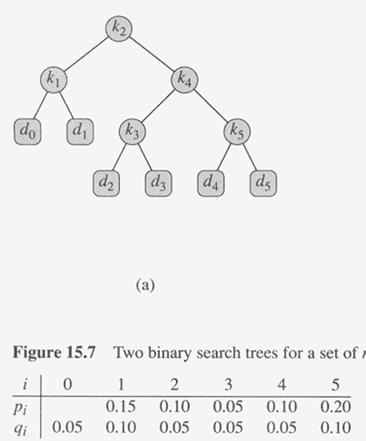
Cost of searching a BST
Key k_{j} is the search target with probability p_{j}
Someone searches for a missing element (d_{j}) between keys k_{j} and k_{j+1} with probability q_{j}.
q₀ is the probability of searching for an element with key less than k₁ (d₀).

Slide 57
Cost of searching a BST
Node | Depth | Prob | cost
K1 | 1 | .15 | 0.30
K2 | 0 | .10 | 0.10
K3 | 2 | .05 | 0.15
K4 | 1 | .10 | 0.20
K5 | 2 | .20 | 0.60
D0 | 2 | .05 | 0.15
D1 | 2 | .10 | 0.30
D2 | 3 | .05 | 0.20
D3 | 3 | .05 | 0.20
D4 | 3 | .05 | 0.20
D5 | 3 | .10 | 0.40
TOTAL |  |  | 2.80

Slide 58
Optimal Substructure in Optimal BST
If an optimal BST T has a subtree T’ containing keys k_{i},…,k_{j}, then T’ must be optimal for a BST with keys k_{i},…,k_{j} and dummy keys d_{i-1},…,d_{j}.
Key k_{j} is the search target with probability p_{j}
Someone searches for a missing element between keys k_{j} and k_{j+1} (d_{j}) with probability q_{j}.
q₀ is the probability of searching for an element with key less than k₁ (dummy element d₀).

Slide 59
Recursion
For the subtree containing keys from i to j, let e[i,j] be the expected cost of searching that subtree
(given item and failure probabilities)
Let w(i,j) be the probability that the target element is in that subtree.
Then, if r (i ≤ r ≤ j) is the root of the subtree containing keys from i to j,
e[i,j] = min_{r}(e[i,r-1] + e[r+1,j] + w[i,j])

Slide 60
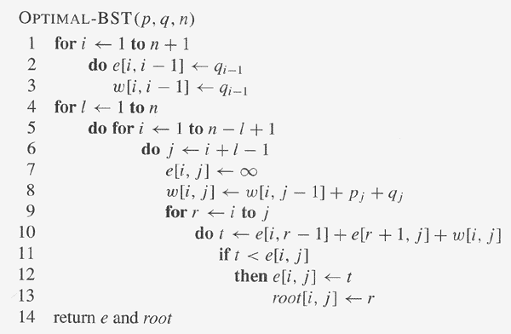
Copyright © The McGraw-Hill Companies, Inc. Permission required for reproduction or display.

Slide 61
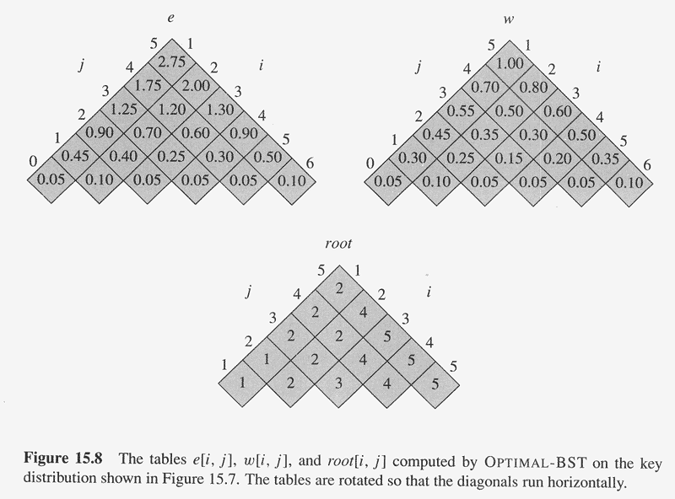
Copyright © The McGraw-Hill Companies, Inc. Permission required for reproduction or display.

Slide 62
Dropping a Cell Phone
Suppose you have designed a new, tough case for a cell phone, and you want to know
“from how many inches can someone drop a cell phone without it breaking?”
Assume you have c cell phones, and you only care about people dropping it from reasonable heights, so there is a maximum height of h inches.
If a cell phone doesn’t break, assume it is just as good as new (you can test with it again at a greater height).
Goal: Minimize the number of drops (trials) needed in the worst case.

Slide 63
Dropping a Cell Phone II
Call this problem phonebreak(c,h)
Special case: If we have 1 cell phone, all we can do is drop it from 1”, 2”, etc. until it breaks. So h trials in worst case.
If a cell phone breaks after dropping from i inches, the problem reduces to phonebreak(c-1,i-1)
If a cell phone doesn’t break after dropping from i inches, the problem reduces to phonebreak(c,h-i) (*)
(*): h-i is the number of trials. Of course, they all are at a higher height than i.
So phonebreak(c,h) = 1 + min(max(phonebreak(c-1,i-1), phonebreak(c,h-i))
i∈{1,2,…,h}

Slide 64
Shortest Bitonic Tour for TSP I
One way to get a possibly better tour than using some arbitrary order of cities is to do a Bitonic Tour.
Start at the southernmost city, go north to the northernmost city, then come back south.
There are a number of such tours, we want to find the shortest.

Slide 65
Shortest Bitonic Tour for TSP II
Idea: Scan south to north, maintaining optimal possibilities for each part of the tour.
Sort the cities from south to north. Assume you know the direct route distance between each pair of cities.
If there is no direct route, assume it is some arbitrarily large number (such as Java’s Integer.MAX_VALUE)
The subproblems are paths P_{ij} with i ≤ j. Start at p_{i}, go west to p₁ (stopping at zero or more cities on the way), then go east to p_{j}, picking up the other cities on the way.
p_{i} may be p_{1.}

Slide 66
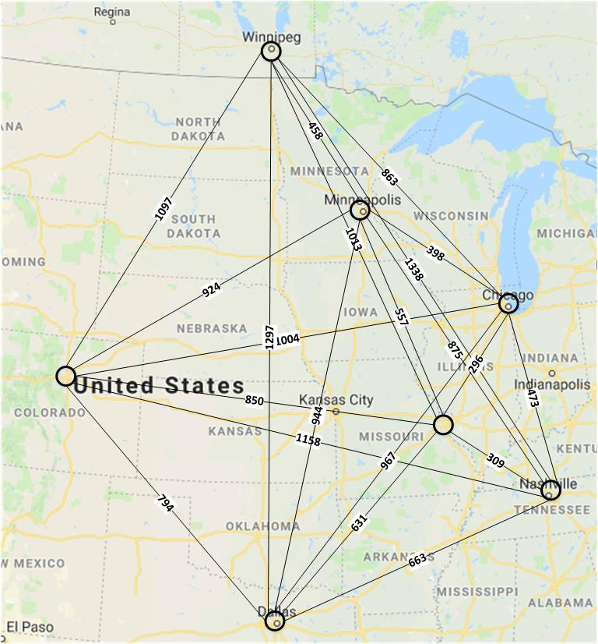
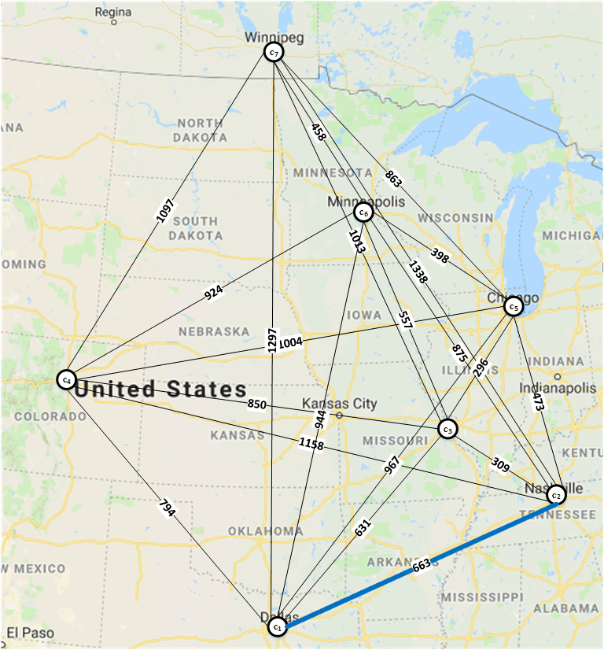
Example of South → North Tour

Slide 67
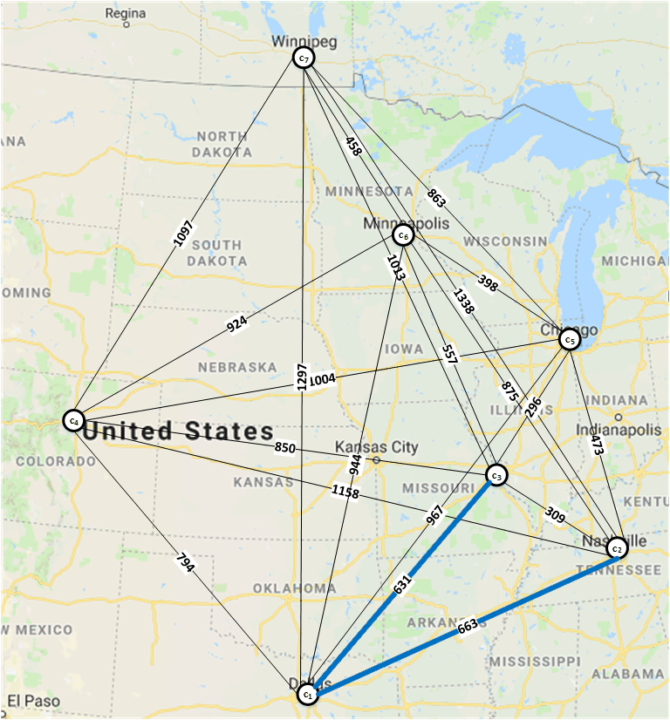
Example of South → North Tour

Slide 68
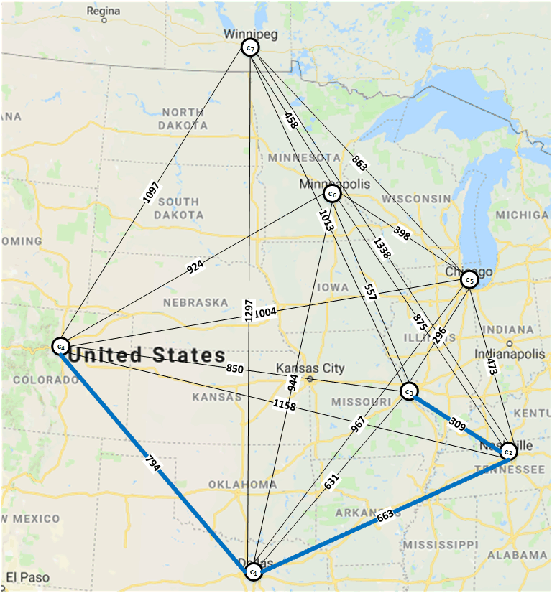
Example of South → North Tour

Slide 69
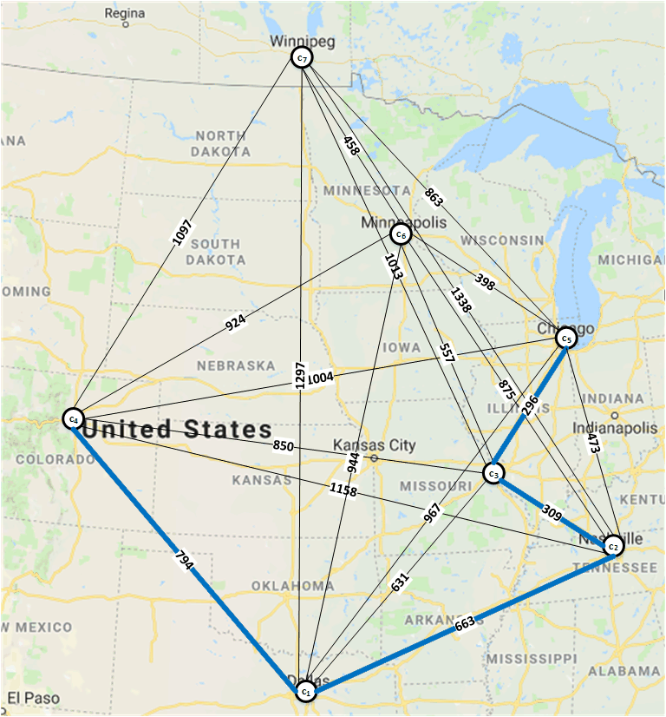
Example of South → North Tour

Slide 70
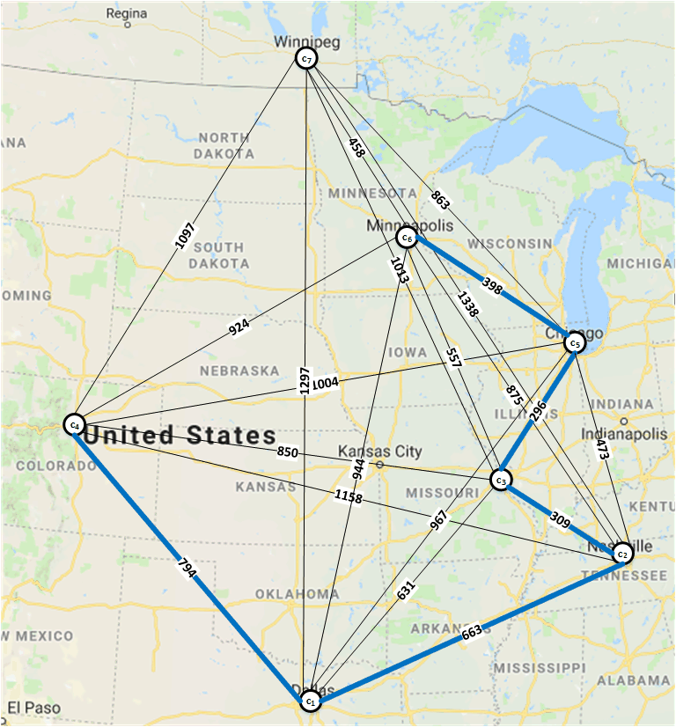
Example of South → North Tour

Slide 71
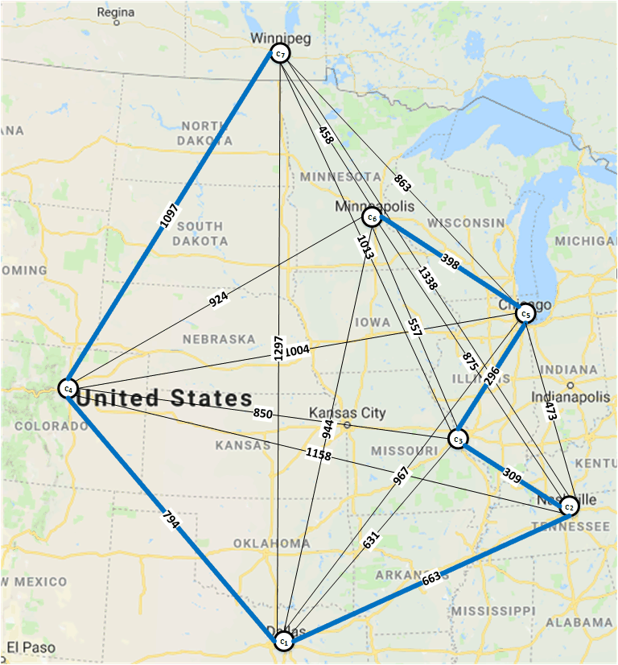
Example of South → North Tour

Slide 72
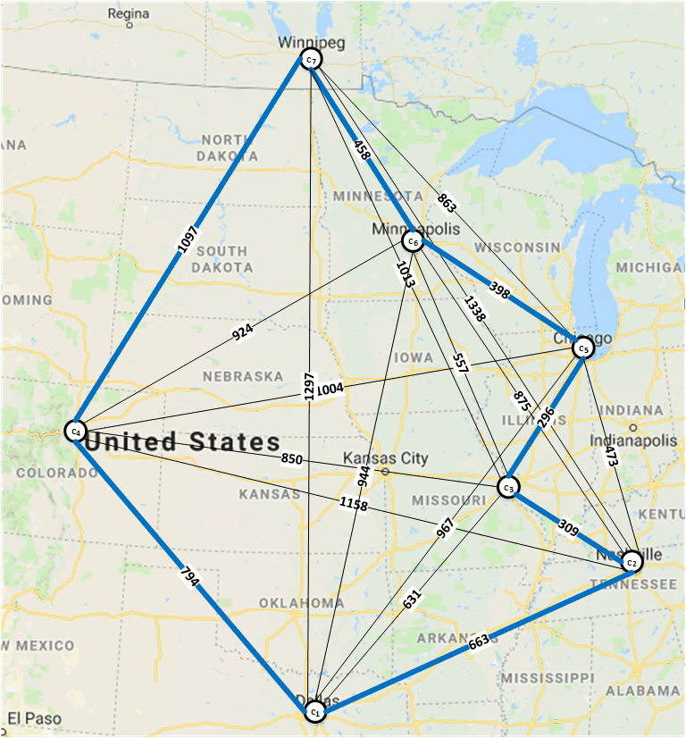
Example of South → North Tour

Slide 73
Bitonic Tour for TSP
More details in Deliverable B Specification, and papers on the Bitonic Tour (see Topic Intros)

